Slide 1
Marketing Brochure
Prof. Ram Meghe Institute Of Technology & Research, Badnera-Amravati

Slide 2
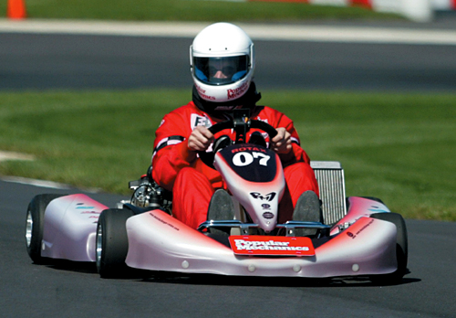
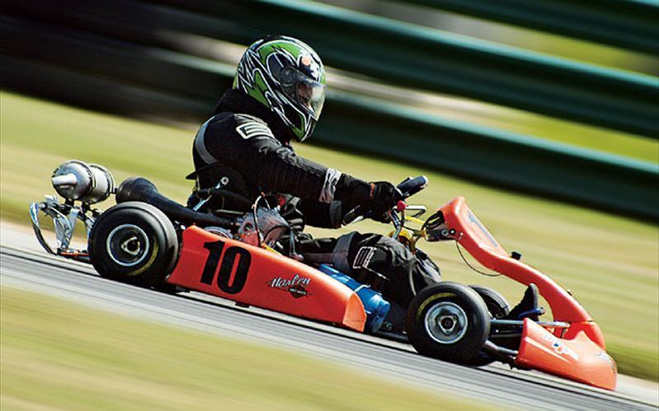
What is Go-kart ?
A Go-kart is a small four-wheeled vehicle. Go-Karting involves driving open-wheeled vehicles, usually around a circuit. It is a great way to get into motor sports, as Go-Karts tend to be easy to drive. There are just two pedals to drive - the accelerator (to speed up) and the brake (to slow down and stop).
If you have never actually seen a Go-Kart before, they are open-wheeled vehicles (with four wheels) that sit very close to the ground. This means that unlike a normal car, you have to sit very close to the ground. This can feel strange at first, but it is something that you quickly get used to.

Slide 3
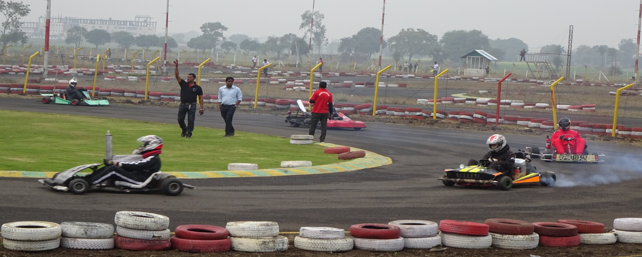
About NKRC
National Kart Racing Championship - 2015 is a National Level Go-Kart Racing Event in which Engineering Students from across the country need to Design and Fabricate their own Go-Kart Vehicle. The event is organized by Virtualis Motorsports which aims for practical development of an Engineering Student. More than Rs. 3,60,000 worth of prizes to be won & also on spot Job Drive for Final Year Student. Best of all the Dynamic Event held at RPM International Racing Track, Bhopal.
This event is aimed to bring out the innovative and creative potential of young automobile enthusiasts. Under Graduate students from different technical streams can participate in event. The basic outline of event consist of designing and fabricating a Go-kart and then competing with those Go-karts in final race. The real essence of the event lies in sheer engineering practical application and tests in real time.

Slide 4
About Team Acrux
Team Acrux is a team of students from Mechanical Engineering of leading technological institute Prof. Ram Meghe Institute of Technology & Research, Badnera which is established in 1983 having a prestigious standing amongst the top most technical institutes of Maharashtra.
The team is formed by selecting 20 skillful and dedicated students from Mechanical Engg Department. Team Acrux has students who are good with there automotive knowledge and design skills.
The team has participated earlier in Go-kart championship in 2014 and achieved 4th place in racing round whereas final rank was 15th amognst 69 teams all over India.
This year also we are participating in National Kart Racing Championship – 2015.

Slide 5
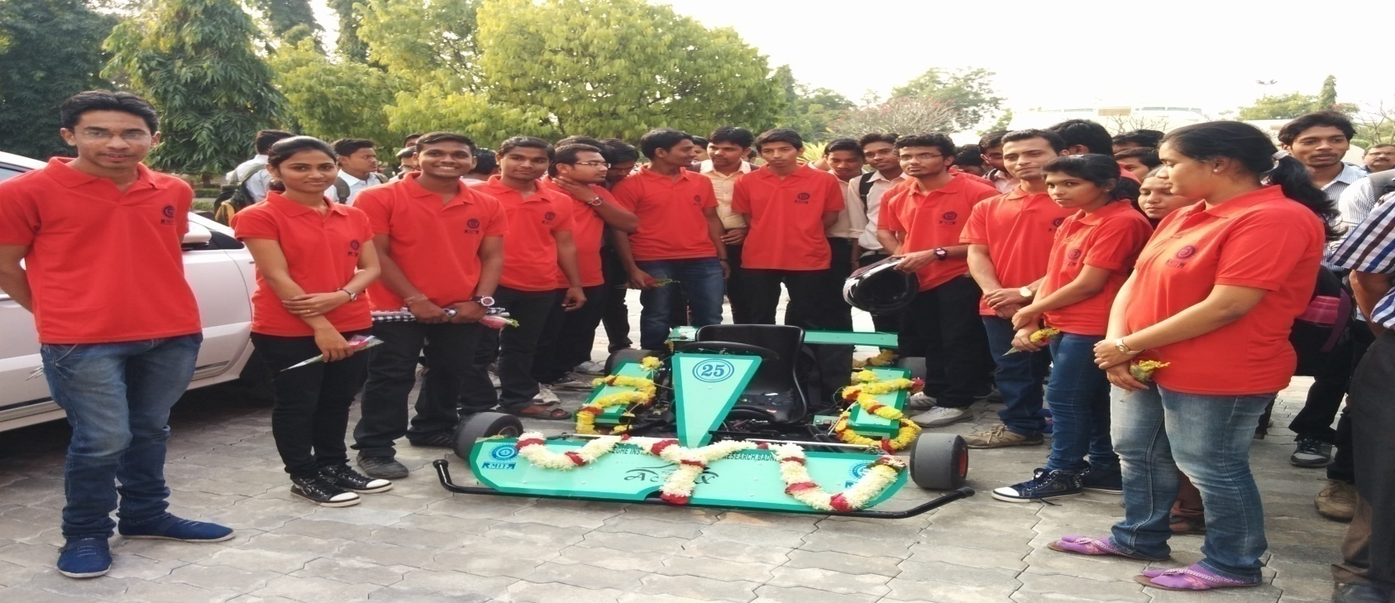
Team Structure
T
E
A
M
A
C
R
U
X
Engine & Powertrain
Harit Kulkarni Suraj Siraskar Mayur Pursani
Karan Tindwani Sameer Harankhedkar
Software Handling
Ketan Dabre
Harit Kulkarni
Shubham Metkar
Roll Cage Design
Vrushali Bhadke Shubham Kinge
Shubham Metkar Saurabh Naik
Braking
System
Ketan Dabre Mayur Durge Snehal Dharmik
Akshay Wakode Akash Umale
Marketing
Shivchandra Band
Ashwini Dhote
Saurabh Naik
Steering System
Ashwini Dhote Shrichinmay Vivrekar
Shivchandra Band Akanksha Kohale

Slide 6
How will be the vehicle ?
Engine : Bajaj Discover 125 cc
Max Speed : 60 kmph
Acceleration : 1.18 m/s²
Weight : 97 kg
Max Power : 8.1 kW
Max Torque : 10.8 Nm

Slide 7
Sponsorship Benefits
Extensive Media Coverage
National Kart Racing Championship is the most followed Go-Kart racing event in India. The teams and the Event receives extensive media coverage during various tests and racing.
Visibility Among The Required
Since the event is witnessed by many automobile engineers, executives of leading automobile companies and students interested in automobile.
Association With Leading University Teams
Your association with our team will provide you more attention as there will be students, professionals and visitors from all over India.
Promotion In Our City
Publicity during college Technical Events, Departmental Events, College Magazine, Newspapers and other promotional events of college.

Slide 8
Team Acrux is the only team from Amravati University to clear the Presentation Round of NKRC – 2015 and achieved 13th rank amongst 102 teams from all over India.
Thus qualified for the Final Racing Round.
Being the only team from our city, it is bound to attract adequate local media coverage and students from various colleges.
Your organization will be stated as our official sponsor in all such coverage.
Your Organization’s Name will be displayed on the Team Acrux’s official facebook page along with the brief description of your organization and also link to your official website.
On site banners in the team’s pit at event site.
Sponsorship in the form of direct money will be highly helpful because of its flexibility in team’s investment.

Slide 9
Sponsors
Platinum
Gold
Silver
Name and Logo of organization on :-
Front panel of Go-kart
Team T-shirts ( front side )
Race suit of driver
Promotional & onsite pit banners
Official facebook page
Drivers helmet
Name and Logo of organization on :-
Side panel of Go-kart
Team T-shirts ( rear side )
Race suit of driver
Promotional banners
Official facebook page
Name and Logo of organization on :-
Side panel of Go-kart
Team T-shirts ( sleeves )
Promotional banners
Official facebook page
INR 25,000/-
INR 20,000/-
INR 15,000/-

Slide 10
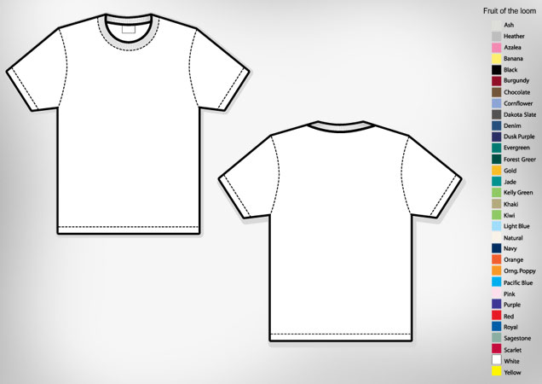
Silver Sponsor
Name & Logo
Positions
of
Name & Logo
Team Logo
Platinum sponsor
Name & Logo
Team name
Gold sponsor
Name & Logo
Silver Sponsor
Name & Logo
Platinum Sponsor
Name & Logo
Gold Sponsor
Name & Logo

Slide 11
Cost Estimation
Sr No. | Item | Description | Price | Quantity | Total
1. | Roll Cage Material | 25.4 x 2 mm | 288/m | 9 m | 2,592
 |  | 25.4 x 1.65 mm | 227/m | 13 m | 2,951
 |  | 31 x 2 mm | 335/m | 5 m | 1,675
2. | Steering System | Steering Wheel & Column | 1500 | 1 | 1,500
 |  | Tie Rods | 400 | 2 | 800
 |  | Stub Axle | 1200 | 2 | 2,400
3. | Braking System | Brake Disc | 900 | 1 | 900
 |  | Calliper | 1535 | 1 | 1,535
 |  | Master Cylinder | 1250 | 1 | 1,250
4. | Wheels | Rim & Tyre ( front ) | 4000 | 2 | 8,000
 |  | Rim & Tyre ( rear ) | 4700 | 2 | 9,400
 |  | Nozzles | 100 | 4 | 400
5. | Powertrain | Engine | 30000 | 1 | 30,000
 |  | Drive Shaft | 2300 | 1 | 2,300
 |  | Chain Sprocket | 1940 | 1 | 1,940
 |  | Exhaust | 2100 | 1 | 2,100
6. | Electrical System | Battery | 1300 | 1 | 1,300
 |  | Brake Light | 400 | 1 | 400
 |  | Kill Switch | 2700 | 2 | 5,400
7. | Seat | Seat | 1400 | 1 | 1,400
 |  | Seat Belt | 800 | 2 | 1,600
8. | Manufacturing | Welding & Bending | - | - | 2,970
 |  | Pedestal | 300 | 2 | 600
 |  | Nuts & Bolts | 1000 | - | 1,000
 |  | MS Sheet | 138/ft² | 7 | 966
 |  | Wheel & Sprocket Hub | 400 | 4 | 1,600
 |  | Pedals, Spring,Cables,etc | 1050 | - | 1,050
9. | Others | Fire Extinguisher | 1100 | 2 | 2,200
 |  | Panels & Paint | 2500 | - | 2,500
10. | Transport | Go kart transport | - | - | 10,000
 | Total (approx) |  |  |  | 1,03,329 /-

Slide 12
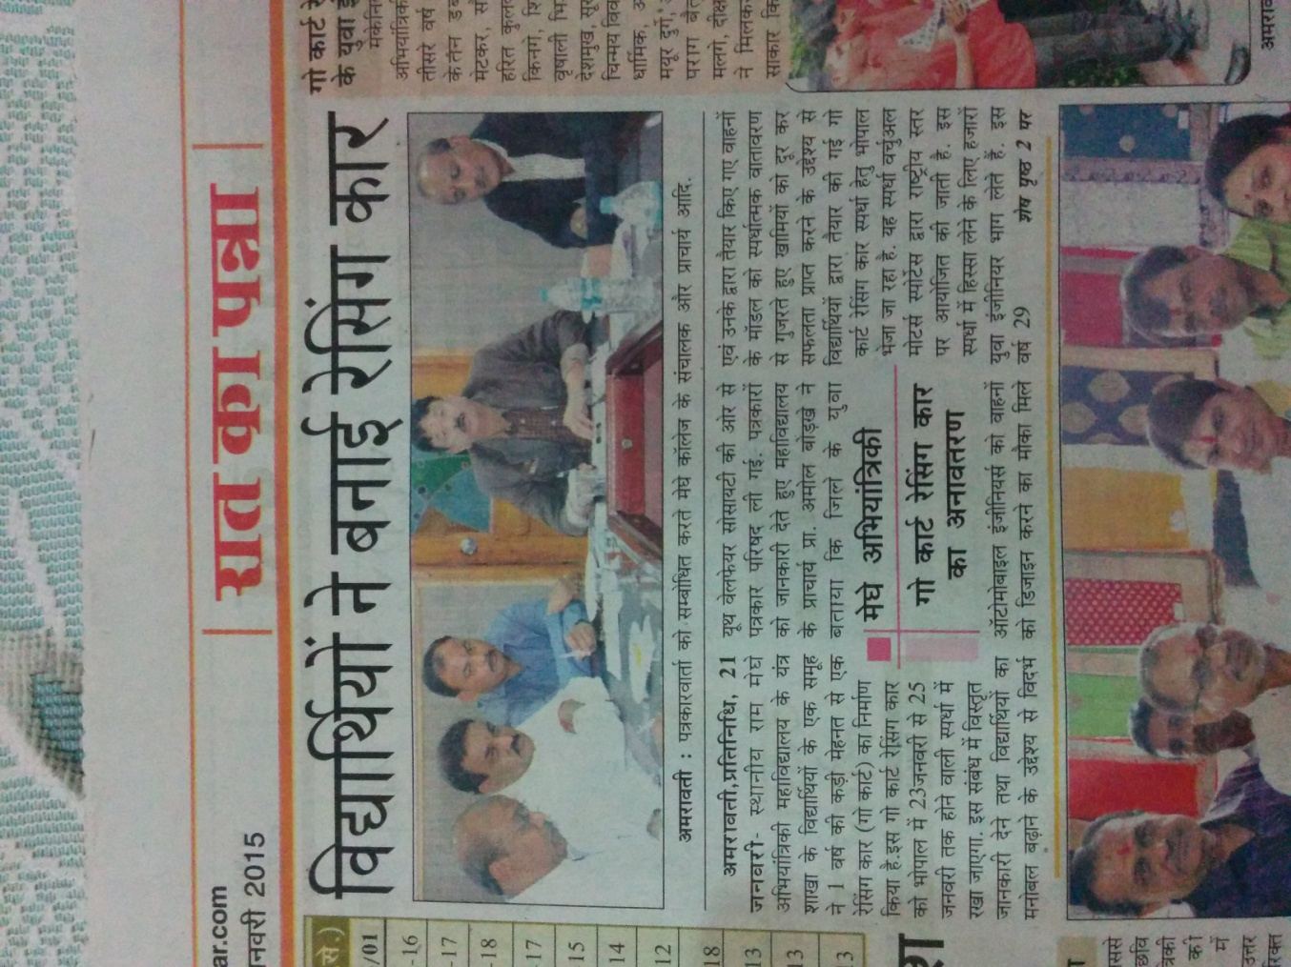
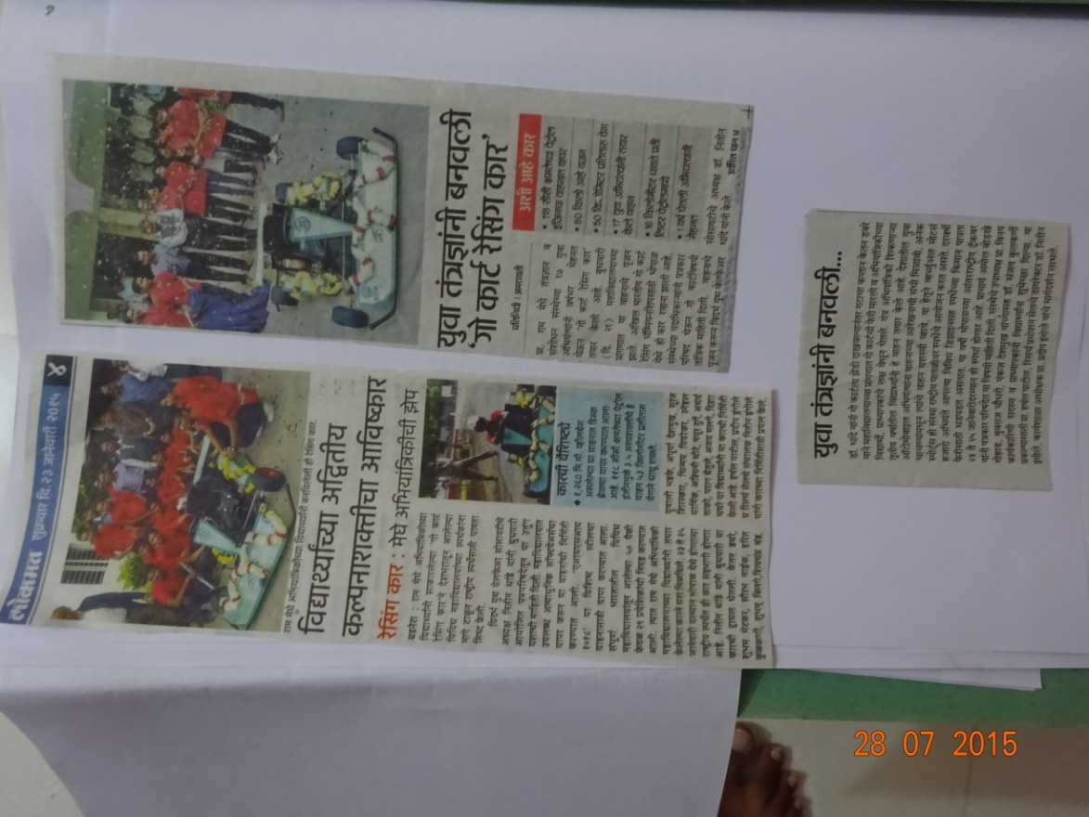
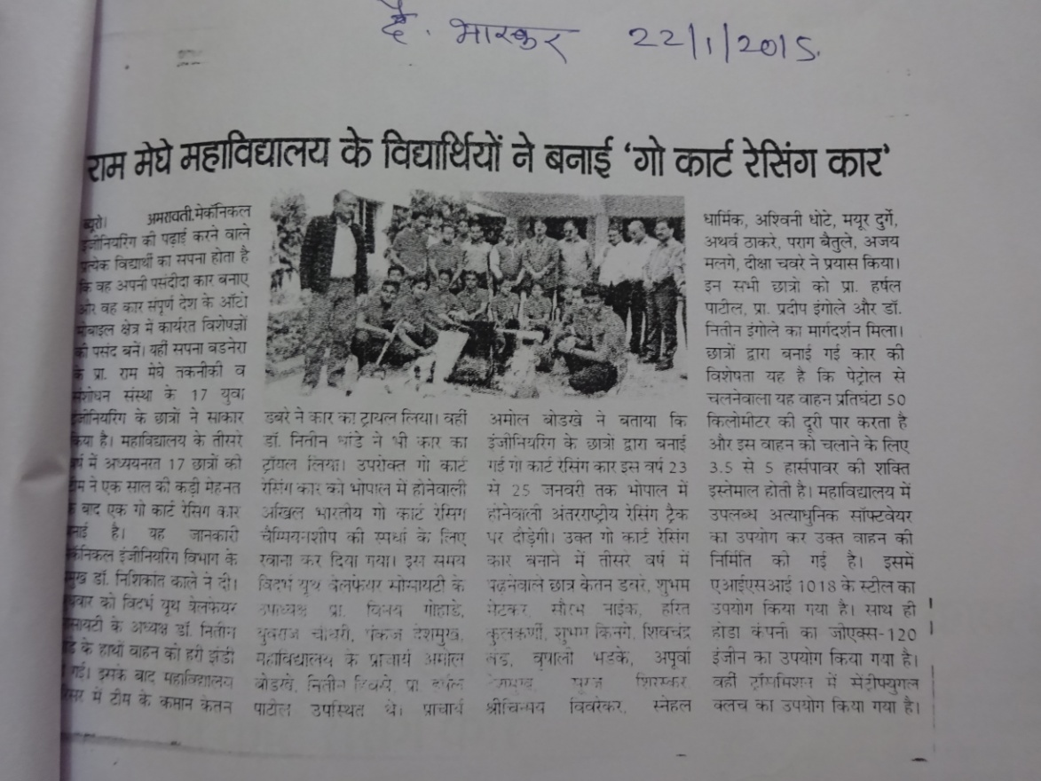
Media Coverage

Slide 13
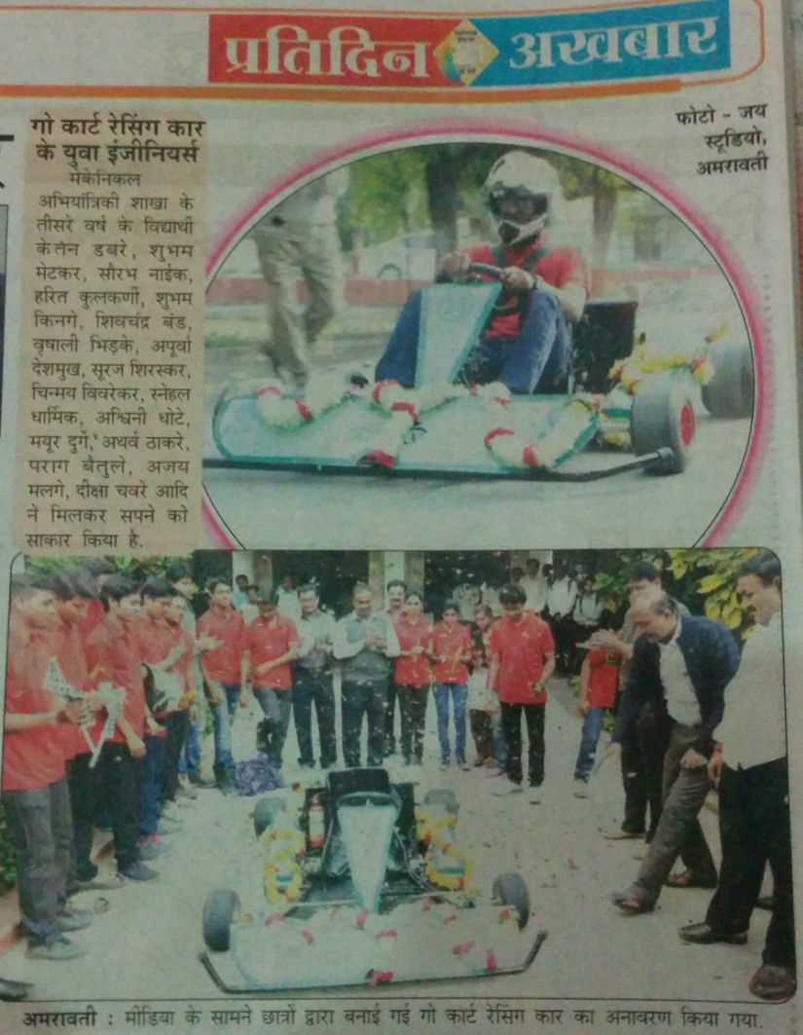
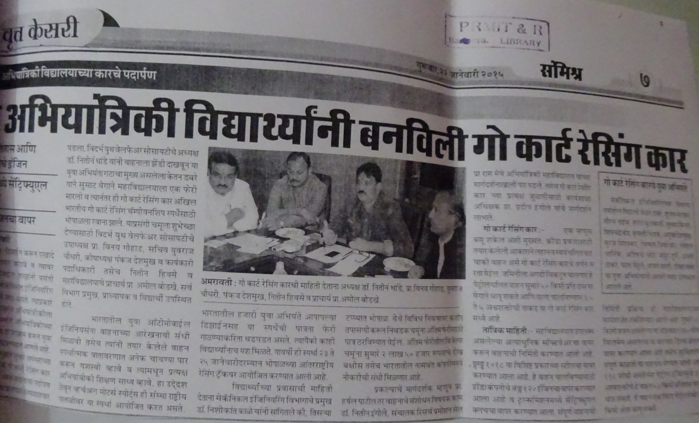

Slide 14
Contacts
Team Acrux
Prof. Ram Meghe Institute of Technology & Research, Badnera
Faculty Advisor
Prof. Harshal Patil
+91 9860690078
harshalpatil1986@rediffmail.com
Team Captain
Shubham Metkar
+91 8308902232 shubhammetkar60@gmail.com
Vice Team Captain
Ketan Dabre
+91 9970830166
ketandabre@gmail.com
Marketing Head
Saurabh Naik
+91 8657978599
saurabh.naik321@yahoo.in
Visit us at
www.facebook.com/teamacruxracing
E-mail : teamacrux@gmail.com
College website : www.mitra.ac.in

